Slide 1

HOTEL
BOOKING
DATA
ANALYSIS
Name- Aditya Maurya
Reg no.- 12206243
Email – mauryaaditya7565@gmail.com

Slide 2

OUTLINE
Introduction
Methodology
Results
Visualization – Charts
Conclusion

Slide 3

INTRODUCTION
Analysis parameter of Hotel booking data
Total Number Of Bookings Across Different Years
Non-Canceled vs Canceled Booking Percentage
Deposit Policies Of Hotels
Demand Trend Of Hotels Year-wise
Top 10 Countries With Maximum Customers
Booking type by country (Top 10)
Total Number Of Bookings Across Various Market Segment
Accommodation Type – Single, Couple & Family
Reservation Status in Hotels
Average Daily rate by months
Cancellations per month

Slide 4
METHODOLOGY
1. Data Loading: Load the Hotel booking dataset into the code using the pandas library Perform initial data exploration to understand the structure and content of the dataset
2. Data Cleaning and Manipulation: Handle missing values, remove duplicates, and perform necessary data transformations. This step ensures the data is in a suitable format for analysis.
3. Exploratory Data Analysis (EDA): Use pandas matplotlib, and seaborn libraries to explore the dataset Analyze different variables, their distributions, and relationships Generate various visualizations such as bar plots pie charts, and scatter plots to uncover patterns and trends.
4 Customer Analysis: The primary objectives were to analyze key metrics such as booking patterns, customer segments, seasonal trends, and cancellation rates. This analysis aimed to provide valuable insights for hotel management and stakeholders to enhance operational efficiency, improve customer experience, and boost profitability.
5 Hotel booking Analysis: understand customer behaviors, preferences, and trends in hotel bookings to enhance marketing strategies, improve services, and increase overall bookings.

Slide 5
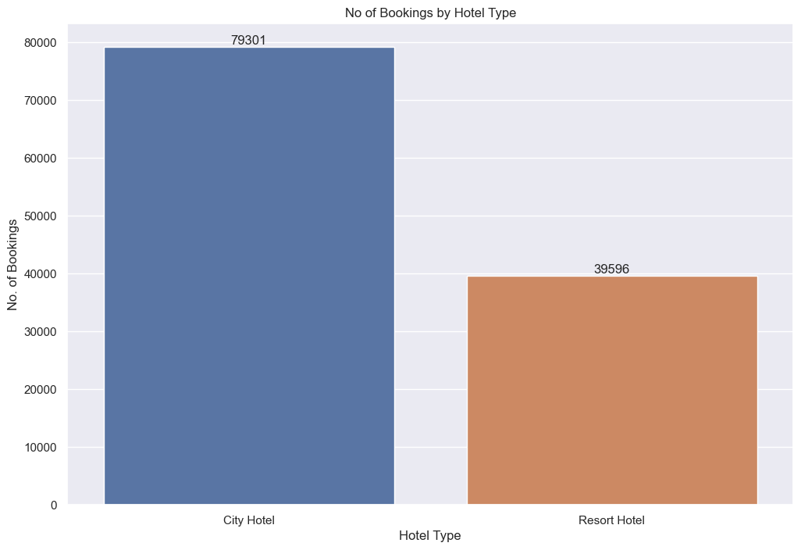
Total Number Of Bookings
The majority of the hotels booked are city hotels.

Slide 6
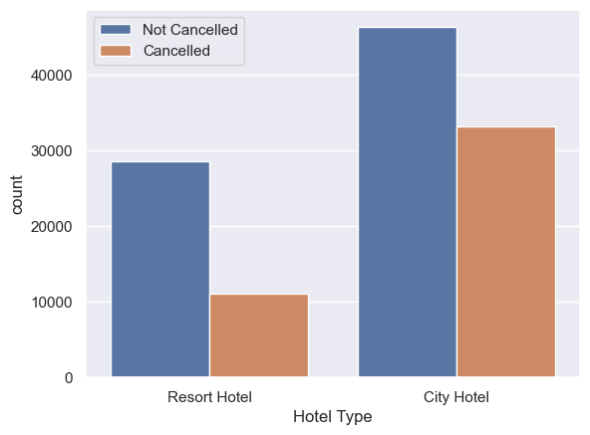
Non-Canceled vs Canceled Booking Percentage
The cancellation rate at city hotels is higher than at resort hotels

Slide 7
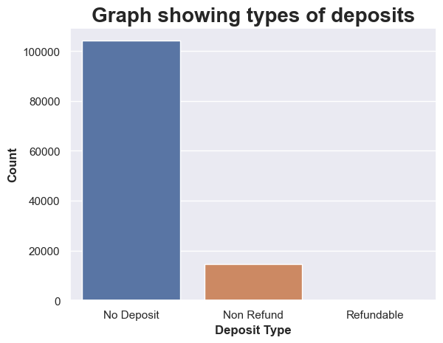
Deposit Policies Of Hotels
A very large number of hotels have a “No Deposit” policy, which may be the reason for the high number of cancellations. To avoid these cancellations and to increase profit and customer retention, the “No Deposit” policy should be changed.

Slide 8
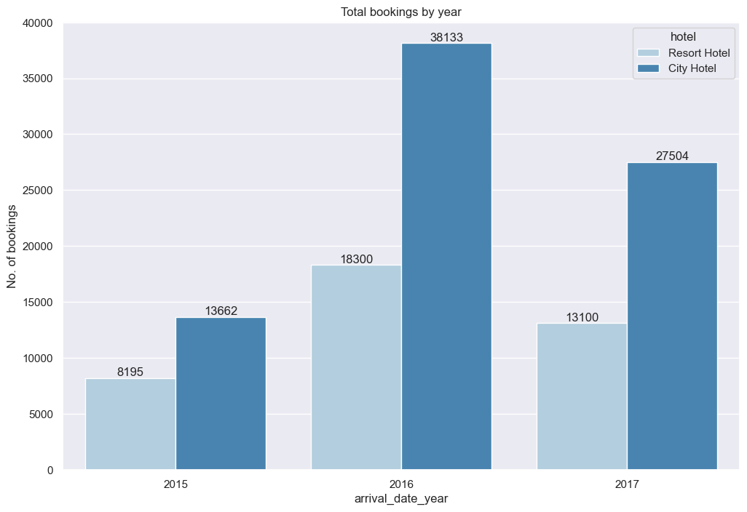
Demand Trend Of Hotels Year-wise
The demand for city hotels is higher than for resort hotels.

Slide 9
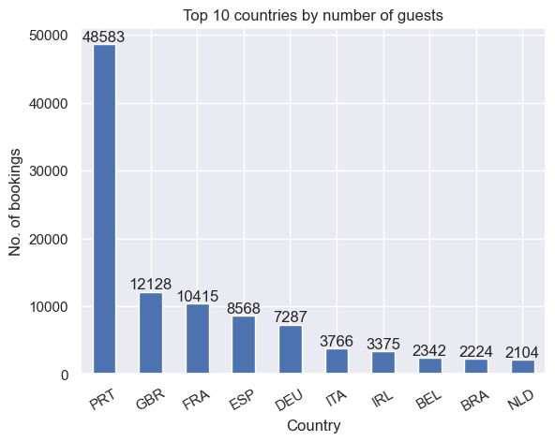
Top 10 Countries With Maximum Customers
The PRT country has the maximum number of customers

Slide 10
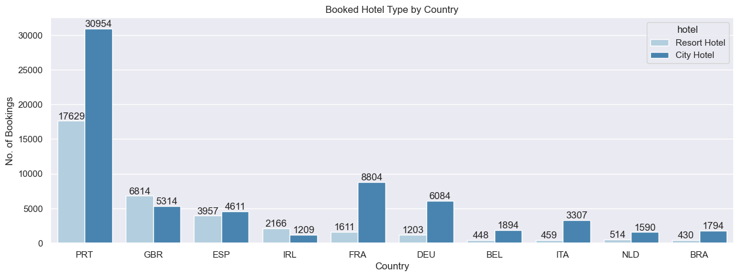
Booking type by country (Top 10)
The booking percentage of city hotels is higher than that of resort hotels

Slide 11
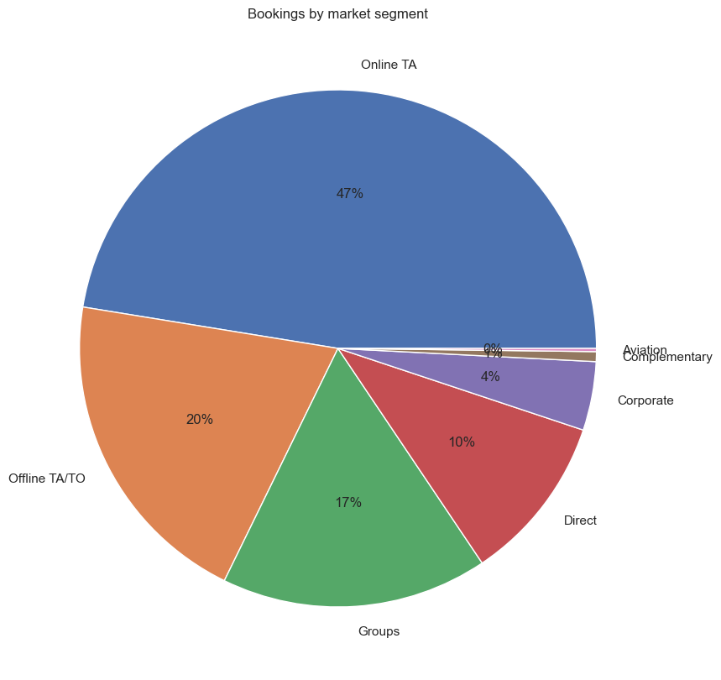
Total Number Of Bookings Across Various Market Segment
The majority of bookings are done by online TA, with 47%.

Slide 12
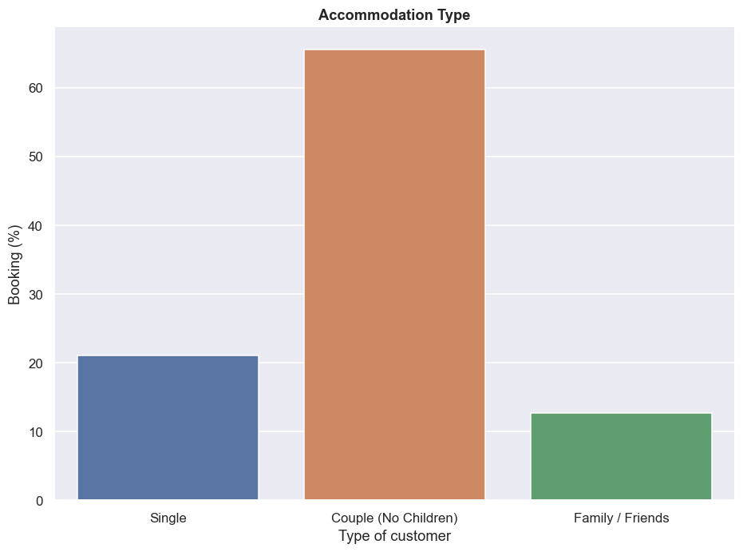
Accommodation Type – Single, Couple & Family
Most rooms are booked by couples who have no children.

Slide 13
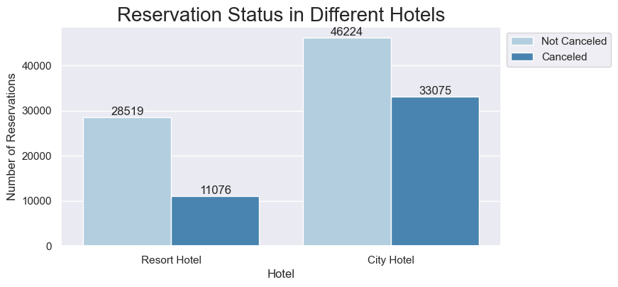
Reservation Status in Hotels
The cancellation rate at city hotels is higher than at resort hotels

Slide 14
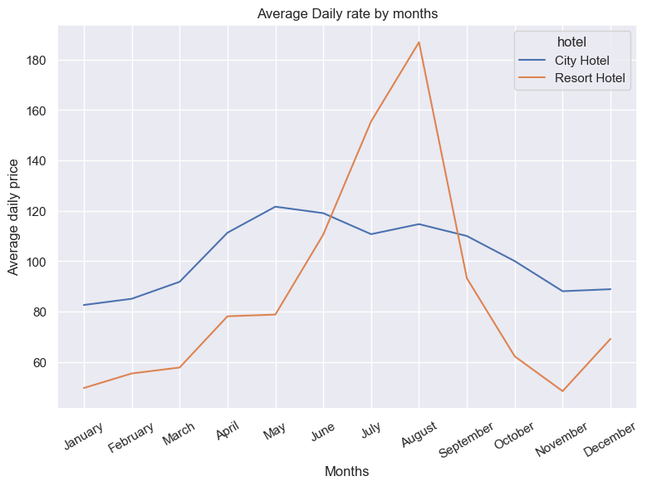
Average Daily rate by months
The price of the city hotel is higher than the resort hotel, except in July when the resort hotel is more expensive. In June and August, both hotels have the same price

Slide 15
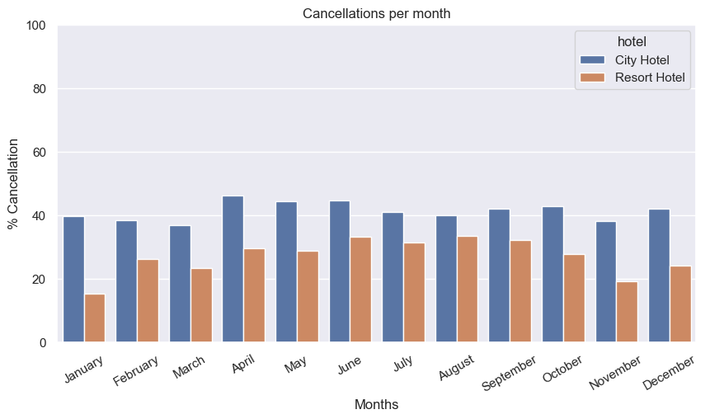
Cancellations per month
The cancellation rate at city hotels is higher than at resort hotels

Slide 16
Conclusion
The majority of the hotels booked are city hotels. We need to spend the most targeting funds on those hotels.
The cancellation percentage at city hotels is higher than at resort hotels.
The demand for city hotels is higher than for resort hotels.
Very large amount of hotels have “No Deposit” Policy. And this may be the reason for the cancellation of the high amount of bookings. To avoid this booking cancellation, in account to collect more profit and customers- “No Deposit” policy should be changed.
We also realize that the high rate of cancellations can be due to high no-deposit policies.
We should also target months between May and August because these are peak months.
More cancellation occurs when prices are higher.
Most rooms are booked by couples who have no children
The cancellation rate at city hotels is higher than at resort hotels
The price of the city hotel is higher than the resort hotel, except in July when the resort hotel is more expensive. In June and August, both hotels have the same price

